Slide 1
Database Security:
Is your data vulnerable?
Presented by: Mary R.Sweeney
Sammamish Software
msweeney@sammamishsoftware.com
Notes:
In this session you’ll learn what your test team needs to know about protecting your server, your database connections, controlling access to your database tables and restricting access to the database server itself.
If your data is in jeopardy, your entire system is at risk. Learn the basics about testing to ensure protection for the critical database component.
In this session you’ll learn what your test team needs to know about protecting your server, your database connections, controlling access to your database tables and restricting access to the database server itself.
If your data is in jeopardy, your entire system is at risk. Learn the basics about testing to ensure protection for the critical database component.

Slide 2
Four major areas of Concern
Server Security
Database Architecture
Database Connections
Table Access

Slide 3

Securing your database server
This is the highest importance; if you can’t get to the data you can’t harm it.
The database server should not be made openly available
No anonymous connections
Web server and database server should not be on the same machine!

Slide 4
Securing your database server
Database server should only respond to known IP addresses.
  If the database is supplying a web server then the database server should only respond to the web server’s IP
  If supplying internally then only internal addresses should be recognized
Test case?
  Attempt to attach to the database server using an unknown IP. Attempt this at various times, including before and after backups and during planned (and unplanned) component failures.
Use example of banking software

Slide 5

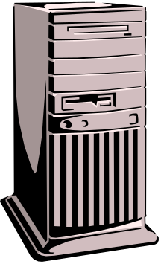
Database/Web Server
Trusted IP address architecture
DMZ
Database server
Web server
Notes:
In computer networks, a DMZ (demilitarized zone) is a computer host or small network inserted as a "neutral zone" between a company's private network and the outside public network. It prevents outside users from getting direct access to a server that has company data. (The term comes from the geographic buffer zone that was set up between North Korea and South Korea following the UN "police action" in the early 1950s.) A DMZ is an optional and more secure approach to a firewall and effectively acts as a proxy server as well. In a typical DMZ configuration for a small company, a separate computer (or host in network terms) receives requests from users within the private network for access to Web sites or other companies accessible on the public network. The DMZ host then initiates sessions for these requests on the public network. However, the DMZ host is not able to initiate a session back into the private network. It can only forward packets that have already been requested.
Users of the public network outside the company can access only the DMZ host. The DMZ may typically also have the company's Web pages so these could be served to the outside world. However, the DMZ provides access to no other company data. In the event that an outside user penetrated the DMZ host's security, the Web pages might be corrupted but no other company information would be exposed. Cisco, the leading maker of router s, is one company that sells products designed for setting up a DMZ.

Slide 6
Preventing database access:
More things to consider
Many strategies for preventing open access each database and OS has their own
Some additional things to consider:
  Server account disabling (3 tries and out does help)
  Kerberos – ticket based authentication system (Oracle and Windows)
  Role-based security rather than user based security
  Authentication servers

Slide 7
Caution
Although network security is the first and most important level of defense, it doesn’t stop there
At some point, data is processed in and out of the system and it is at this point your data is vulnerable

Slide 8
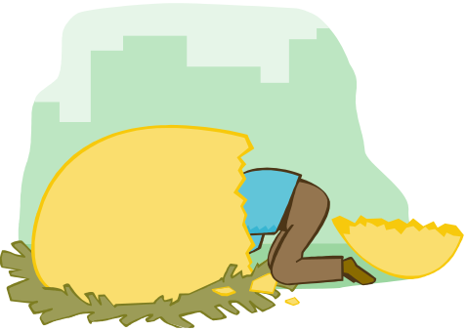
Database Architecture
Database architecture should be properly coordinated with hardware/network architecture
  Doesn’t always get considered with respect to security
  Example: web databases can have secure interfaces to a main database residing on a different server
  Security is about layers. Provide more layers between your data
Employ common sense:
  Internal databases should not be placed on the same server as customer/client databases e.g.., web databases

Slide 9

Consider multiple unpredictable clients/input
Cookies
Registry Input
Temp files
Administrator’s app
Company Intranet
Interoperability
(web services, etc.)
Downloads from
other systems
Client/Server
Database server(s)
Hidden users

Slide 10
Detailed Database Architecture
Logical design should be modified to support secure tables for sensitive information
Stored procedures and views should be used to limit access to the underlying database structure
  User permissions for applications can be assigned to stored procedure and views so that users need not have access or even knowledge of the underlying database structure

Slide 11
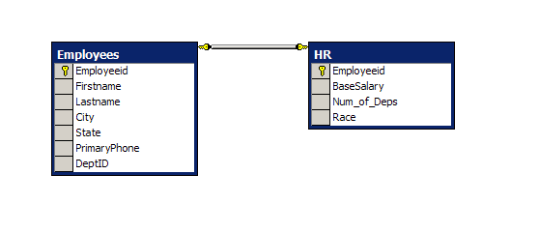
Logical Design Split table

Slide 12
Inside the data layers
Database Layer
Data Access Layers
Database Layers
Database(s)/
Data Stores
Stored
Procedures
Views
Tables
Database(s)/
Data Stores
Stored
Procedures
Views
Tables
Custom Class
Presentation
Layer/
UI
Stored Procedure
Stored Procedures
Data Table
Custom Class
Functions
Data Table
Custom Class
Functions
Functions
Views
Data Table

Slide 13

Architecting Authentication and Permissions
Windows User
Logins/
Group
Database Layer
SQL Server
Logins and Users
Northwind
SQL Server
Roles
Stored Procedure
Stored Procedures
Data Table
NW_Admin
Katie
/NW_Admin
NW_Admin
Functions
Data Table
NW_EmpUser
Functions
NW_EmpUser
Functions
NW_WebUser
Views
Data Table
NW_WebUser
Anh
/NW_WebUser

Slide 14
Referencing tables with Views and Stored Procedures
Create Procedure HRProc (EmpID int)
as
Begin
select Employeeid, Firstname, Lastname,
basesalary, num_of_deps
from Employees e, HR h
where e.Employeeid = h.Employeeid and
Employeeid = @EmpID;
End;
Grant Select on HRPRoc to HRUser
Create View EmpView as
Select Firstname, Lastname, PrimaryPhone
From Employees;
Grant Select on Empview to WebUser

Slide 15
Secure user connections
Design proper access
  This may seem like a given but is very common to give too much authority to basic users. Why?
    Developers use full permissions to develop and then if the system breaks when they limit permissions the incentive is to complete the project quickly letting full permissions stand.
    Neophyte developers with not enough training
    Permissions should be effected down to the column level; users should have read-only permissions to most data

Slide 16
Secure User Connections
Test cases
Test Cases
  Test application security using all different available security levels. Attempt activities outside the range of a normal user
  Even normal update capability; ie., for users to modify quantities on an order, can allow for the ability to improperly update other things!

Slide 17
SQL Injection
Difficult to thoroughly check for SQL Injection vulnerability
  Development teams are notoriously inconsistent; some areas may not be vulnerable while others are
  Answer: test every area for data entry.
  Assume if you don’t then the hacker will

Slide 18
Example: SQL Injection Attacks
ABC Corp. Login Form:
Username:
‘or 1=1; drop table user; --
Password:
Turns this query:
Select username from user where username = ‘someuser’
and pass = ‘somepass’
Into this query:
Select username from user where username = ‘’ or 1 = 1;
drop table user; -- and pass = ‘’
Notes:
SQL injection attacks can be particularly insidious. They can range from those trying to get passwords into secure systems for personal gain to those that are intentionally malicious. An excellent article about these attacks can be found at DevArticles.com http://www.devarticles.com/art/1/138. Of course the referenced article talks about what they are and how to prevent them which is important information for us, of course, but our job is to write tests to ensure that these attacks have been properly prevented. In other words we write tests to simulate a SQL-Injection attack and determine how the application handles them. It should go without saying that this needs to be performed on a test database!

Slide 19
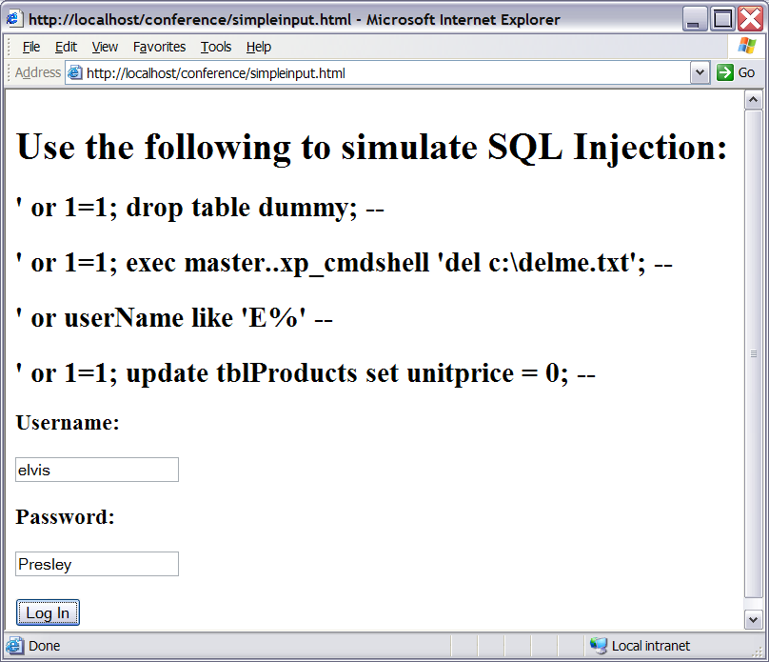
Test cases for SQL Injection

Slide 20
Test cases for Data security
Testers must be familiar with current hacking techniques
Use Penetration testing techniques
Tools are available (AppDetective, etc.)
Try SQL Injection in all areas
  Create a dummy table and attempt to insert into it, update it or even delete it
Sweeney:
Often I tell my students we can only do effective field level integrity testing on high priority areas because of time constraints. However this thinking is exactly the thinking that the hacker exploits. They look for underused portions of the application for security holes. Good security-focused testers do this too.

Slide 21
Why should test professionals know DB Basics?
Not all members of a test team need to know it
  Need at least one person on the team who is DBA level
Those team members assigned to verify data transformations within the application MUST know it!
  Can look for and find more common design problems
  Can speak intelligently about how to address/fix data issues
Notes:
A common misconception in testing is that you can test and uncover data issues within an application by ignoring the backend and testing only on the front-end of the system. However, this approach ignores the layers we discussed earlier and makes it more difficult to isolate the bugs found. Today’s testers must be sharper and more knowledgeable.

Slide 22
Why should test professionals know DB Basics?
Isn’t this a development task?
  Isn’t this the same as Unit testing?
  QA does not and should not replace good unit and integration testing strategy by development
Development tests are usually built to ensure functionality and do not typically incorporate full QA, ie., a full test of the component
  Example: Development harness accesses component and executes basic methods but doesn’t do any testing of valid or invalid input, equivalence class testing, boundary analysis, etc.

Slide 23
Why should test professionals know RDBMS Design basics?
Inadequate knowledge of Relational db design fundamentals leads to logic errors and very common bugs in systems
  Basic normalization principles can and should be tested but aren’t -- because most testers have no idea what that is!
Effective DB testers should be able to uncover design problems quickly
Able to recognize neophyte developer errors easily
  A test pro with DB background can uncover poor design bugs by adding a number of basic tests
Notes:
The intent of this course is to focus on SQL in a test environment but we will review DB design basics since lack of understanding of these essentials can lead to common problems in an application. The test professional cannot expect to be proficient in SQL yet ignorant of relational DB design fundamentals.

Slide 24
Why should test professionals know SQL Basics?
SQL statements can be used to:
  Verify SQL statements used within the app
  Insert and remove test data
  Verify existence of data integrity on the DB
  Reveal corrupt data
    Duplicate data
    Orphan records
  Create and run automated tests in the
  DB backend
  Create test cases to protect against common DB hacks; we must be as smart as hackers!
Notes:
If you’re testing an application which has the primary focus of moving data between users and relational data stores, then knowledge of Structured Query Language is essential to be able to efficiently and successfully test the application’s use of data. The list above of possible applications is merely the short list. There many possible uses for SQL in a test environment. In the following section we will study SQL essentials from the perspective of the Test Professional.

Slide 25
Review/Summary
Server Security
Database Architecture
Database Connections
Table Access
Many of these things have been around awhile and yet still are unused! Many systems still have System Administrator accounts with no passwords! Don’t let your systems be easily broken into.

Slide 26
Recommendations
When planning systems testing don’t forget to target the database, looking at both
  architecture and
  employing focused testing
Stay abreast of bug track web sites to find holes in your security testing
  www.securityfocus.com/archive
  www.ntbugtraq.com

Slide 27
References
Database Security -- Common-sense Principles (Paper) By Blake Wiedman www.governmentsecurity.org
Litwin, Paul. www.deeptraining.com
SQL Injection Attacks DevArticles.com
  www.devarticles.com/art/1/138
Whitaker/Thompson. How to Break Software security
Frank Swiderski and Window Snyder. Threat modeling

